Slide 1

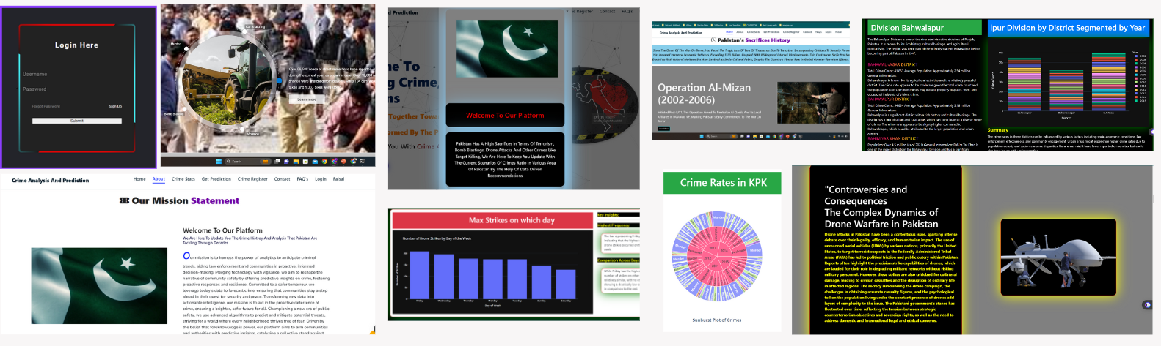
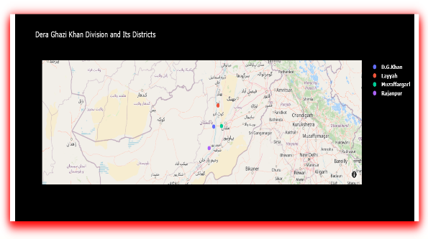
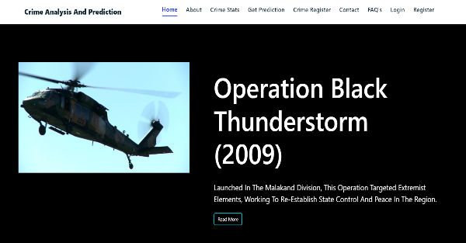
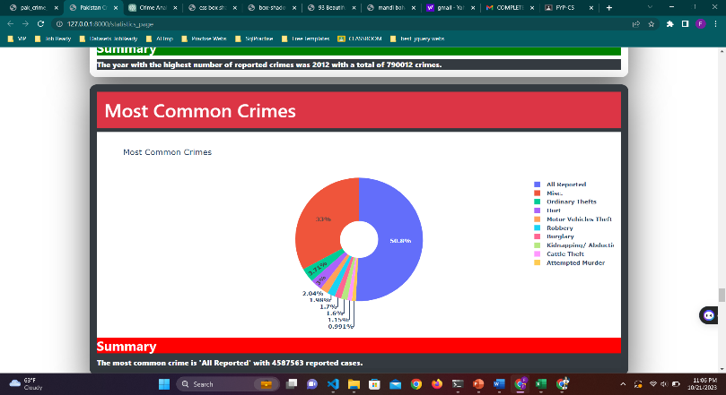
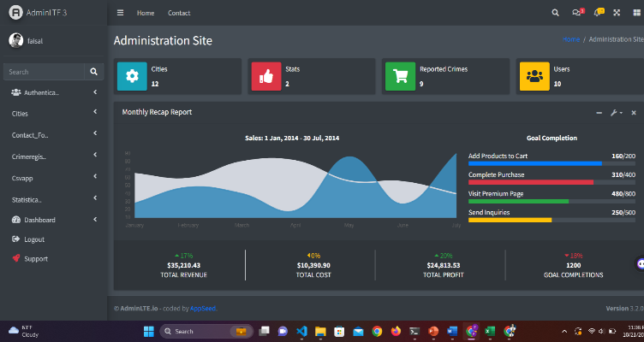
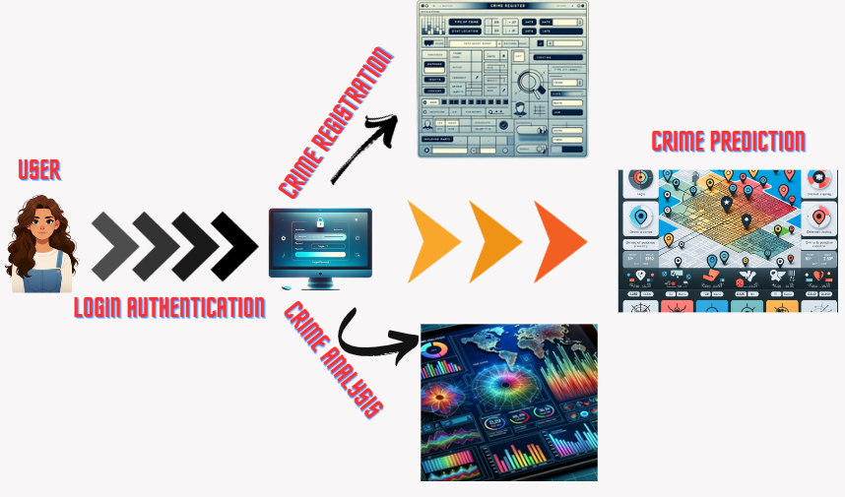
CRIME ANALYSIS AND PREDICTION
Faisal Mehmood Awan
Muhammad Salman Shahid
Supervisor: Mr. Muhammad Haris
ABSTRACT
GOALS
This project analyzes and predicts crime trends in Pakistan, using advanced data analysis and visualization. It identifies patterns of criminal activities in various areas, offering easy-to-understand insights. By using Natural Language Processing and Deep Learning, it also predicts city safety. The user-friendly models are helpful for everyone, including policymakers, law enforcement, and the public.
Uncover crime trends with in-depth analysis.
Translate data into easy-to-understand visuals.
Predict safety with cutting-edge technology.
Empower people with accessible crime insights.
Enhance public safety and community vigilance.
USER INTERFACES
PROBLEM STATEMENT
Pakistan has endured decades of violence, including terrorism and crime, significantly affecting its people and stability. However, there's a lack of a platform offering detailed crime data to the public. This information gap leaves many, from journalists to tourists, without the knowledge needed for safe living and informed decisions, undermining transparency and community action.
Figure 1. User Interfaces
METHODOLOGY
OBJECTIVES
We aim to collect and preprocess extensive crime data in Pakistan, identify crime patterns, and create easy-to-understand visualizations. Our goal is to build predictive models using NLP and Deep Learning to forecast crime hotspots and safety levels. We're also focused on making our findings accessible to everyone and engaging with the community for better decision-making. Lastly, we plan ongoing updates to our data and models for lasting accuracy and relevance.
Figure 2. Research Methodology
CONCLUSION
Secure user login
In-depth crime analysis
Interactive maps and charts
Direct crime reporting feature
Predictive safety assessments
Intuitive platform design

